Slide 1
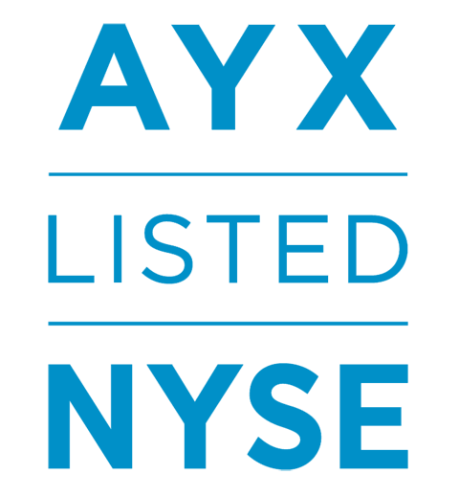
TECHNOLOGIE PARTNER
Notes:
Hello Everyone and thank you for your time today. I’d like to spend the next 10 minutes or so giving you an overview of Alteryx and the capabilities we provide. I’ll leave plenty of time for questions as well as plan to give you all a quick demo to further highlight some of our capabilities.
As an intro - Alteryx is a software company that delivers an end-to-end analytics platform that helps companies turn their data into actionable insights which in turn, improves their businesses. We’re known for data prep and blend, helping shape and analyze different types of data so that it can be more easily dashboarded and visualized. We’ve extended beyond prep & blend into an end-to-end analytics platform that helps all data professionals – IT, analysts, and data scientists – more easily manage their data and analytic models across the enterprise.
We became a public software company in March 2017 (NYSE: AYX)
Our corporate headquarters is in Irvine, California, and our main development center is in Broomfield, Colorado.
We have regional offices in Silicon Valley, Chicago, Dallas, Toronto; Copenhagen, London, Munich, Prague, Singapore and Sydney.
We are supported by Key Technology and Strategic Alliance Partners including Microsoft, Tableau, Amazon Web Services, KPMG, Accenture, and WiPro.
We have over 550 employees and 250 plus partners around the world
We have a Worldwide presence with 3400+ customers across NA, EMEA, APJ, and South America/LATAM.
FY17 Reported Financials = 132M revenue & 130% net revenue retention rate

Slide 2
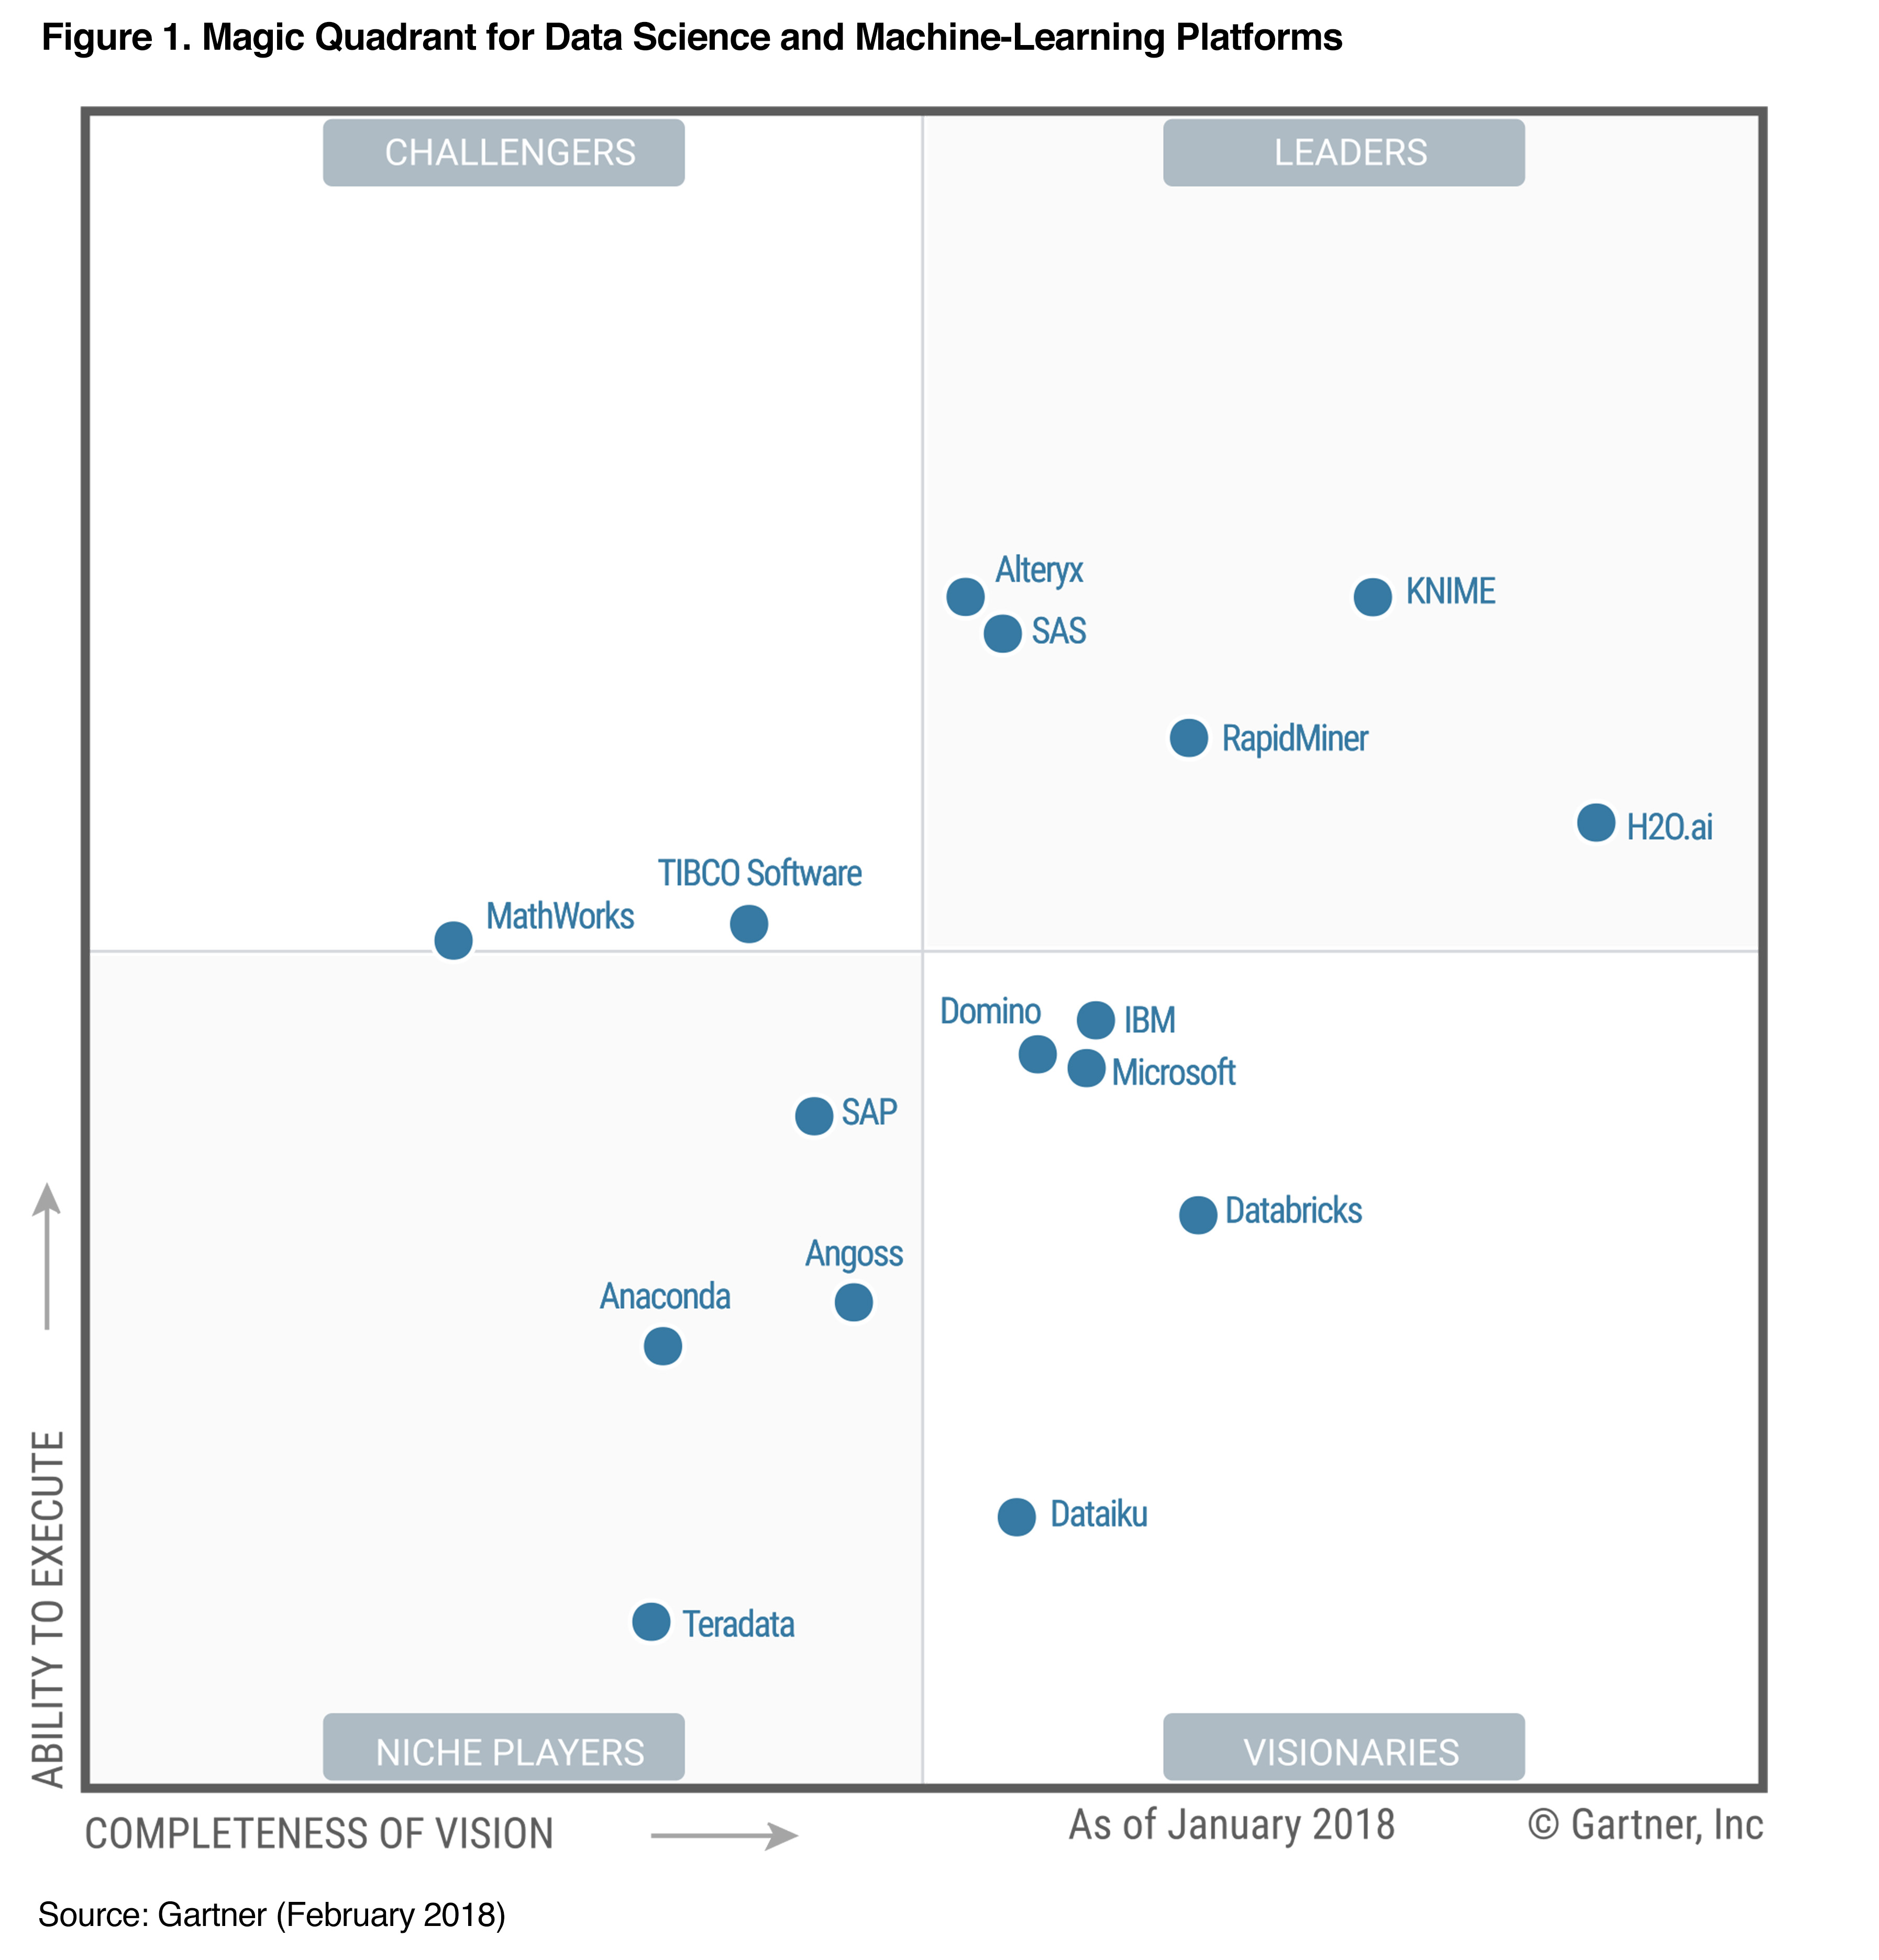
DATA
SCIENCE UND MACHINE-LEARNING PLATFORMEN
Notes:
Alteryx believes it has received validation from a number of industry analysts and 3rd-parties, including Gartner. We feel that our customers have voted with their wallets and we have garnered the vote that matters most, yours: Alteryx is the Gold Award winner of the 2017 Gartner Peer Insights Customer Choice Awards in BI and Analytics platforms.
In March 2018, we were listed as a Leader in the Gartner Magic Quadrant for Data Science and Machine-Learning Platforms. And while there are lots of Magic Quadrants from Gartner, we view this Magic Quadrant as the most valuable as it represents where customers and the market are going – evolving BI and analytics by virtue of data science and machine learning. From our view. over the next 10 years, data science and the need for higher order analytics is going to eat the world.
Not only have we been named a leader in Gartner’s 2018 MQ for Data Science and Machine Learning, we are the only single platform solution to offer a comprehensive end-to-end analytics platform that serves not only data scientists but the many business analysts that are trying to answer important questions for the business.

Slide 3
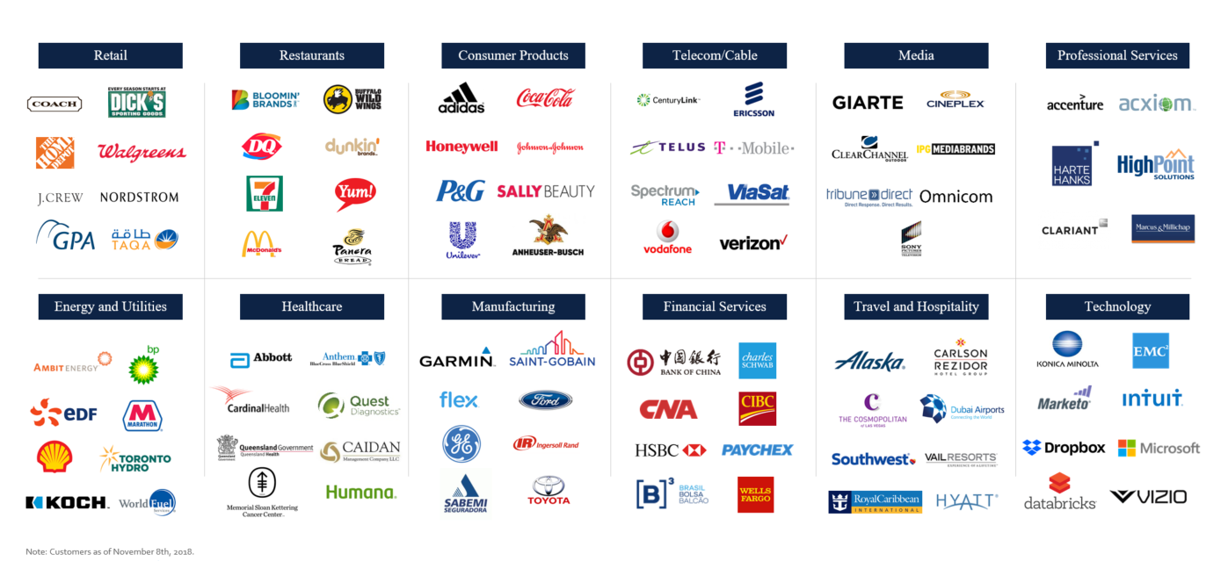
UNSERE KUNDEN
Note: Customers as of November 8th, 2018.
Notes:
Organizations of all sizes and across a wide variety of industries have adopted our analytics solutions. We are known for our quick time-to-value and helping companies and agencies realize the benefits of self-service data science & analytics.
We have earned the trust of thousands of customers around the world, ranging from many of the world’s largest and best known brands, who all want to use the power of data for a competitive edge.

Slide 4
TODAY Data ChaoS
HIDDEN DATA
COMPLEX DATA LANDSCAPE
INEFFICIENT MODELLING
LOST PRODUCTIVITY
37%
5+
80%
23%
TIME, SEARCHING FOR RELEVANT DATA
5 OR MORE DATA SOURCES
TIME, SPENT ON MANUAL DATA PREPARATION
ONLY 23 % OF DATA SCIENCE MODELLES GO LIVE
IDC, The State of Data Discovery and Cataloging
HBR, Data Blending: A Powerful Method for Faster, Easier Decisions
IDC, The State of Self-Service Data Preparation and Analysis Using Spreadsheets
Rexer Analytics Data Science Survey, 2017
Notes:
The reality of data and analytics in most companies today – is complex. There are some big challenges with people, process and technology. Lines of business are struggling to find and manipulate data so that it can be visualized. IT is struggling with the variety and volume of data – and how to securely govern its usage. And finally, data scientists are struggling to get their analytic models into production.
IDC recently did a survey talking to data analysts and leaders. They asked how much time data workers spent searching for the right data asset need to begin the analytics process - analysts reported spending close to 40% of their time trying to even find all the data they need.
To further compound this problem, only 6% have all their data in one place, and the majority of analysts have to pull data from 5 or more sources – spreadsheets, cloud applications, social media, and that data warehouse. And that’s once they even find it!
Once all the data is collected we also see a tremendous amount of inefficiency when it comes to actually working with that data to turn it into insights due to ineffective tools and processes. According to a survey by IDC analysts in North America alone waste what equates to $60 billion per year on repetitive manual spreadsheet work.
And when it comes to embedding and deploying the high value data science models, data scientists reported in a recent survey that only 13% of their data science models get deployed every time.
The State of analytics is complicated by the fact that most companies are using a variety of tools, from different vendors and these tools don’t allow solve for the challenges above, only exacerbate them and reinforce the silos that exist between IT, analysts, and data scientists.
Holding on to these relics are the biggest barriers to analytic alignment and innovation.

Slide 5
Heute Daten ChaoS
VERBORGENE DATEN
HETEROGENE DATENLANDSCHAFT
INEFFIZIENTE MODELLIERUNG
VERGEUDETE RESOURCEN
37%
5+
80%
23%
SUCHE NACH DATEN
5 ODER MEHR DATENQUELLEN
MANUELLE SPREADSHEET ARBEIT
DER DATA SCIENCE MODELLE GEHEN IN PRODUKTION
IDC, The State of Data Discovery and Cataloging
HBR, Data Blending: A Powerful Method for Faster, Easier Decisions
IDC, The State of Self-Service Data Preparation and Analysis Using Spreadsheets
Rexer Analytics Data Science Survey, 2017
Notes:
The reality of data and analytics in most companies today – is complex. There are some big challenges with people, process and technology. Lines of business are struggling to find and manipulate data so that it can be visualized. IT is struggling with the variety and volume of data – and how to securely govern its usage. And finally, data scientists are struggling to get their analytic models into production.
IDC recently did a survey talking to data analysts and leaders. They asked how much time data workers spent searching for the right data asset need to begin the analytics process - analysts reported spending close to 40% of their time trying to even find all the data they need.
To further compound this problem, only 6% have all their data in one place, and the majority of analysts have to pull data from 5 or more sources – spreadsheets, cloud applications, social media, and that data warehouse. And that’s once they even find it!
Once all the data is collected we also see a tremendous amount of inefficiency when it comes to actually working with that data to turn it into insights due to ineffective tools and processes. According to a survey by IDC analysts in North America alone waste what equates to $60 billion per year on repetitive manual spreadsheet work.
And when it comes to embedding and deploying the high value data science models, data scientists reported in a recent survey that only 13% of their data science models get deployed every time.
The State of analytics is complicated by the fact that most companies are using a variety of tools, from different vendors and these tools don’t allow solve for the challenges above, only exacerbate them and reinforce the silos that exist between IT, analysts, and data scientists.
Holding on to these relics are the biggest barriers to analytic alignment and innovation.

Slide 6
Modern End-to-end Analytics Platform
COMMUNITY
SEARCH, FIND & COLLABORATE
DATA PREP + MODELLING + ANALYSIS
AUTOMATE + DISTRIBUTE
DEPLOYMENT + MODEL MANAGEMENT
DATA SCIENCE & ANALYTICS CULTURE
Notes:
Alteryx takes a different approach to analytics. Our platform is purpose-built to shorten the distance from business problem to business solution.
And it is unique in the simple fact that we provide an end-to-end, unified analytics experience that empowers all data workers to quickly and easily move back and forth between analytic tasks, from:
Discovering the right data assets & collaborating with fellow analysts anywhere across the organization in a governed way
To connecting, prepping, and blending all your data, no matter how exotic or big.
Then quickly moving into developing advanced analytic models in a code-free and code-friendly environment – leveraging visualytics to see how your data changes across your entire workflow, not just the output.
Once models are created we help deploy them into production in real-time, and monitor and manage them, no more month long deployment cycles
Best of all we help automate your processes so you can build once and repeat never.
And because we let you share and publish analytic workflows securely across your organization, we help you break down the analytic silos between teams.
You need to have a solution in place that will bring decentralized data, analytic assets and users together - matching needs and haves, in ways that bypass traditional, legacy methods in order to unlock true value and create a data science and analytics culture at scale.

Slide 7
ModernE End-to-end Analytics Platform
COMMUNITY
SUCHEN, FINDEN + KOMMUNIZIEREN
DATA PREP + MODELLIERUNG + ANALYSE
AUTOMATISIEREN + VERTEILEN
DEPLOYMENT + MODEL MANAGEMENT
DATA SCIENCE & ANALYTICS CULTURE
Notes:
Alteryx takes a different approach to analytics. Our platform is purpose-built to shorten the distance from business problem to business solution.
And it is unique in the simple fact that we provide an end-to-end, unified analytics experience that empowers all data workers to quickly and easily move back and forth between analytic tasks, from:
Discovering the right data assets & collaborating with fellow analysts anywhere across the organization in a governed way
To connecting, prepping, and blending all your data, no matter how exotic or big.
Then quickly moving into developing advanced analytic models in a code-free and code-friendly environment – leveraging visualytics to see how your data changes across your entire workflow, not just the output.
Once models are created we help deploy them into production in real-time, and monitor and manage them, no more month long deployment cycles
Best of all we help automate your processes so you can build once and repeat never.
And because we let you share and publish analytic workflows securely across your organization, we help you break down the analytic silos between teams.
You need to have a solution in place that will bring decentralized data, analytic assets and users together - matching needs and haves, in ways that bypass traditional, legacy methods in order to unlock true value and create a data science and analytics culture at scale.

Slide 8
Notes:
As organizations are starting to understand that business value is going to come from the more sophisticated analytics that are just now making there way into the mainstream, the pressures and demands to embed higher-orders of analytics at scale and across the organizations are increasing, and we’re seeing analytic teams struggle.
More often then not, we find that analytic teams are starting from an insufficiently strong position, attempting to innovate with legacy holdovers of analytics processes, technology and team alignments.
Holding on to these relics are the biggest barriers to analytic alignment and innovation.
We believe there is a better way……….
More often then not, we find that analytic teams are starting from an insufficiently strong position, attempting to innovate with legacy holdovers of analytics processes, technology and team alignments, and are attempting to bridge the old with new demands by stitching old and new methods. This is only going to slow the rate of analytic innovation and evolution within your organization as it’s often a place of comfort, where the lull of learned patterns slow the rate of analytic innovation and evolution.
Holding on to relic systems and processes are the biggest barriers to analytic alignment and innovation. You need to have a solution in place that will bring decentralized data, analytic assets and users together - matching needs and haves, in ways that bypass traditional, legacy methods in order to unlock true analytic value.
What we’ve seen is that for the past few years, the industry was perhaps a bit over-focused on the new interactive visualization paradigm – which did provide some value because it increased engagement and insight, but it didn’t really move us beyond descriptive analytics.
In order to achieve your vision of analytic maturity you have to begin building your analytic process on a solid foundation, we believe that data prep and blending would be a core competency of any analytic system, but should not stop there, it should empower your teams to quickly and efficiently move beyond descriptive analytics regardless of skillset.
Truth is that IT and Line of Business want more capabilities in fewer tools now more than ever before.
The information and the analytics working on the information have moved (or are moving) out of custom disconnected products and into PLATFORMS that are open and flexible to change. And important here is the fact that this modernization needs to be in the hands of a different worker than yesteryears technology – in the business where the context around questions in business exist.

Slide 9
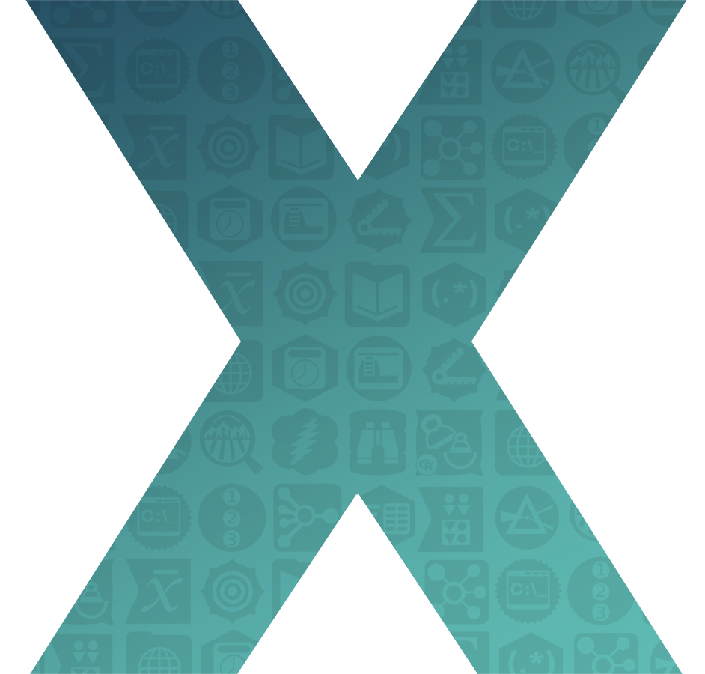
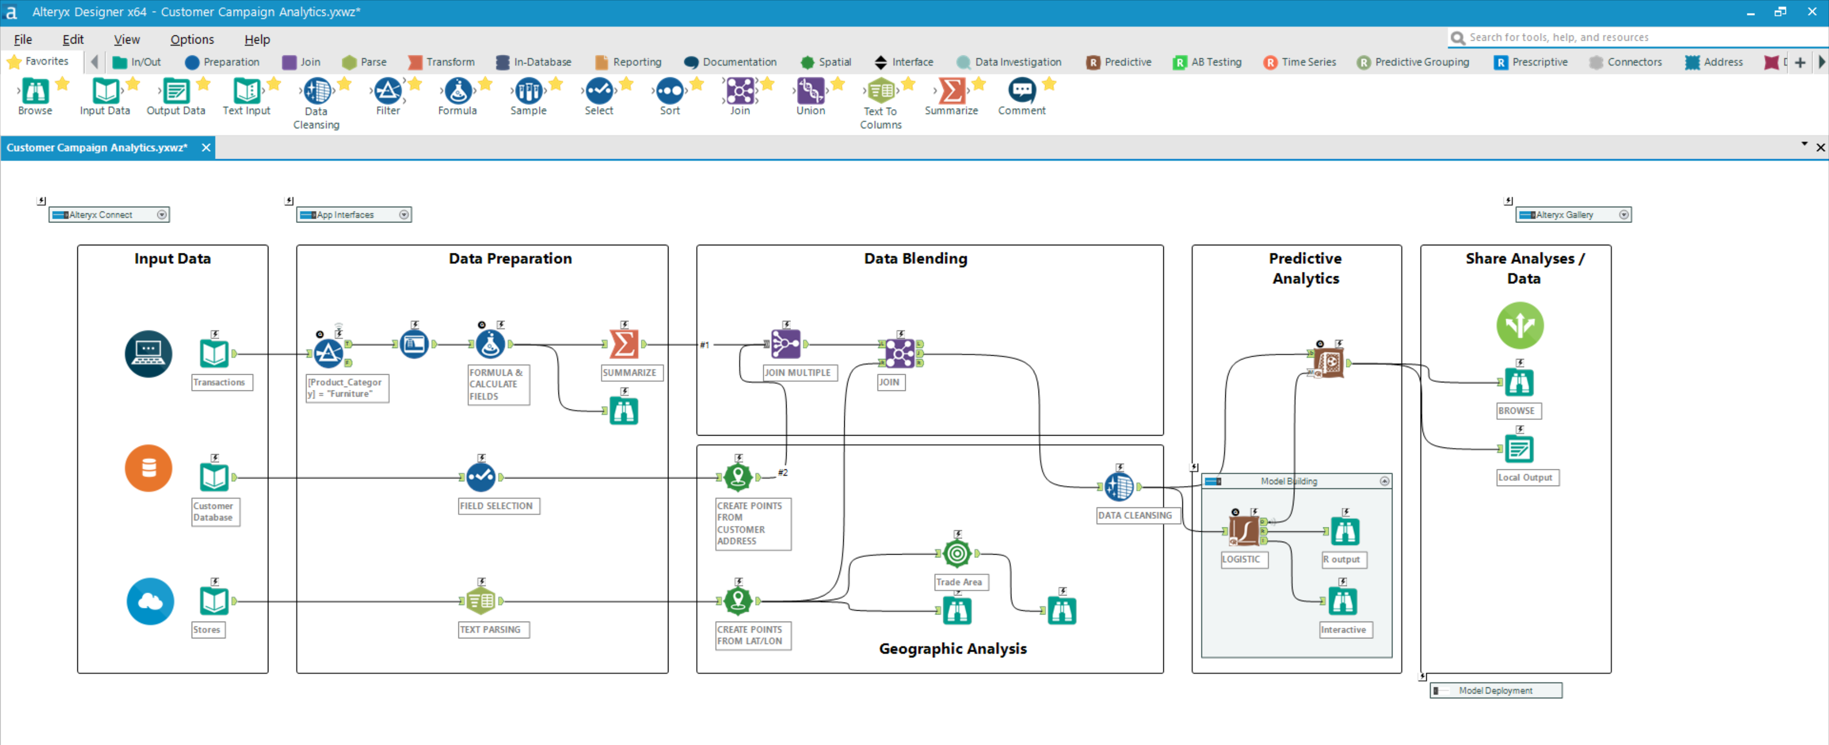
CODE- Free
250+ Analyse Tools
Vordefinierte Modelle
Visualisierungen zum besseren Datenverständnis
Notes:
We know analytic skillsets vary greatly within an organization, here at Alteryx we firmly believe that today’s prep and blending user is tomorrow’s citizen data scientist and this is really the guiding principle of our product investments. We deliver Data Science to the Masses - providing a simple code-free way of performing complex analytic tasks..
Our all Purpose Data Workbench features
A Drag and drop UI for workflow creation that allows your emerging analytic talent upskill quickly.
The flexibility allows analysts sitting in any part of your organization that ability to Prep, blend and analyze for almost any use case with a 250+ tools to perform a wide array of data work.
The Simple yet sophisticated tool configuration allows coupled with visualytics to see your results along the way –help users grow their analytic skillset while feeling confident that they’re building sound insights.
The sharability of the Alteryx workflows allows citizen users to leverage encrypted models from data scientists
Embedded Global search for community support helps your team connect to a built-in group of analytic experts willing and ready to share their expertise.
WHAT IT DOES:
Create powerful code-free workflows for statistical, predictive, and spatial modeling
Leverage dozens of powerful built-in analytic tools to create and modify models – for example, decision trees, forest models, regressions
Incorporate other advanced analytic models written in R & Python using our code-friendly tools
WHAT IT MEANS
Flexibility – delivers support for everything from basic transformations to advanced analytic models.
Visibility - using embedded visualytics within your analytic workflows to check your math along the way.
Less Time/Speed – decrease the time to insights and the ultimately, the time to decision.
Empower more of your data workers to take on more complex analytic tasks and deliver more insights across the organization.

Slide 10
CODE- Free
250+ Analytic Tools
Predefined Models
Visualization for better data understanding
Notes:
We know analytic skillsets vary greatly within an organization, here at Alteryx we firmly believe that today’s prep and blending user is tomorrow’s citizen data scientist and this is really the guiding principle of our product investments. We deliver Data Science to the Masses - providing a simple code-free way of performing complex analytic tasks..
Our all Purpose Data Workbench features
A Drag and drop UI for workflow creation that allows your emerging analytic talent upskill quickly.
The flexibility allows analysts sitting in any part of your organization that ability to Prep, blend and analyze for almost any use case with a 250+ tools to perform a wide array of data work.
The Simple yet sophisticated tool configuration allows coupled with visualytics to see your results along the way –help users grow their analytic skillset while feeling confident that they’re building sound insights.
The sharability of the Alteryx workflows allows citizen users to leverage encrypted models from data scientists
Embedded Global search for community support helps your team connect to a built-in group of analytic experts willing and ready to share their expertise.
WHAT IT DOES:
Create powerful code-free workflows for statistical, predictive, and spatial modeling
Leverage dozens of powerful built-in analytic tools to create and modify models – for example, decision trees, forest models, regressions
Incorporate other advanced analytic models written in R & Python using our code-friendly tools
WHAT IT MEANS
Flexibility – delivers support for everything from basic transformations to advanced analytic models.
Visibility - using embedded visualytics within your analytic workflows to check your math along the way.
Less Time/Speed – decrease the time to insights and the ultimately, the time to decision.
Empower more of your data workers to take on more complex analytic tasks and deliver more insights across the organization.

Slide 11
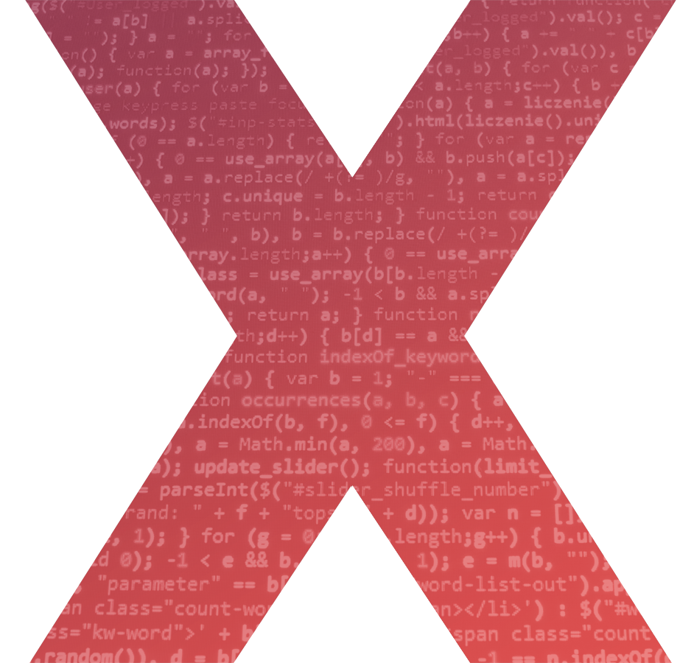
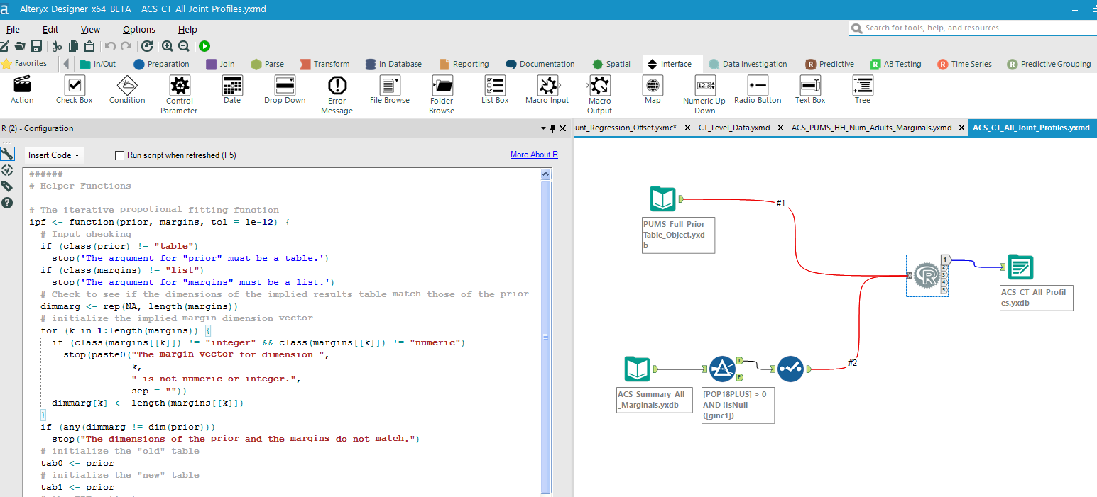
CODE- Friendly
Copy/Paste aus R und Python
Zusammenarbeit von Analysten und Data Scientists
Notes:
Another area of focus is around the trained statistician, and data scientists.
We know performance is key, the Alteryx Engine was built to handle gigabytes of data. The new Engine is built for Terabytes. When you have petabytes, we need to leverage the power of Spark and we need to process data where it lives.
We are adding additional algorithmic support. We already support R, and are adding a brand new Python SDK that will ultimately enable a Python tool for Alteryx Designer.
Alteryx empowers your data scientists to be more efficient, collaborating with your citizen users to offload repetitive tasks using custom R or Python based tools, or macros that then can be used by general analysts.
Both Code-Free and Code-Friendly!
WHAT IT IS
Create powerful code-free workflows for statistical, predictive, and spatial modeling
Leverage dozens of powerful built-in analytic tools to create and modify models – for example, decision trees, forest models, regressions
Incorporate other advanced analytic models written in R & Python using our code-friendly tools
In-line Visualytics to see your results along the way – visually see and check your statistical math along the way
WHAT IT MEANS
Flexibility – delivers support for everything from basic transformations to advanced analytic models.
Visibility - using embedded visualytics within your analytic workflows to check your math along the way.
Less Time/Speed – decrease the time to insights and the ultimately, the time to decision.

Slide 12
CODE- Friendly
Copy/Paste from R and Python
Colloboration between Analysts and Data Science Teams
Notes:
Another area of focus is around the trained statistician, and data scientists.
We know performance is key, the Alteryx Engine was built to handle gigabytes of data. The new Engine is built for Terabytes. When you have petabytes, we need to leverage the power of Spark and we need to process data where it lives.
We are adding additional algorithmic support. We already support R, and are adding a brand new Python SDK that will ultimately enable a Python tool for Alteryx Designer.
Alteryx empowers your data scientists to be more efficient, collaborating with your citizen users to offload repetitive tasks using custom R or Python based tools, or macros that then can be used by general analysts.
Both Code-Free and Code-Friendly!
WHAT IT IS
Create powerful code-free workflows for statistical, predictive, and spatial modeling
Leverage dozens of powerful built-in analytic tools to create and modify models – for example, decision trees, forest models, regressions
Incorporate other advanced analytic models written in R & Python using our code-friendly tools
In-line Visualytics to see your results along the way – visually see and check your statistical math along the way
WHAT IT MEANS
Flexibility – delivers support for everything from basic transformations to advanced analytic models.
Visibility - using embedded visualytics within your analytic workflows to check your math along the way.
Less Time/Speed – decrease the time to insights and the ultimately, the time to decision.

Slide 13
LIVE DEMO
Notes:
Hello Everyone and thank you for your time today. I’d like to spend the next 10 minutes or so giving you an overview of Alteryx and the capabilities we provide. I’ll leave plenty of time for questions as well as plan to give you all a quick demo to further highlight some of our capabilities.
As an intro - Alteryx is a software company that delivers an end-to-end analytics platform that helps companies turn their data into actionable insights which in turn, improves their businesses. We’re known for data prep and blend, helping shape and analyze different types of data so that it can be more easily dashboarded and visualized. We’ve extended beyond prep & blend into an end-to-end analytics platform that helps all data professionals – IT, analysts, and data scientists – more easily manage their data and analytic models across the enterprise.
We became a public software company in March 2017 (NYSE: AYX)
Our corporate headquarters is in Irvine, California, and our main development center is in Broomfield, Colorado.
We have regional offices in Silicon Valley, Chicago, Dallas, Toronto; Copenhagen, London, Munich, Prague, Singapore and Sydney.
We are supported by Key Technology and Strategic Alliance Partners including Microsoft, Tableau, Amazon Web Services, KPMG, Accenture, and WiPro.
We have over 550 employees and 250 plus partners around the world
We have a Worldwide presence with 3400+ customers across NA, EMEA, APJ, and South America/LATAM.
FY17 Reported Financials = 132M revenue & 130% net revenue retention rate

Slide 14
Questions?
Peter Jeitschko
+43 664 157 08 32
pjeitschko@alteryx.com
Notes:
Thanks for your time today.

Slide 15
FRAGEN?
Peter Jeitschko
+43 664 157 08 32
pjeitschko@alteryx.com
Notes:
Thanks for your time today.

